Slide 1
Java IO
Java I/O (Input and Output) is used to process the input and produce the output.
Java uses the concept of a stream to make I/O operation fast. The java.io package contains all the classes required for input and output operations.
Stream
It is a sequence of data/objects that supports various methods. They are used to read or write data. Eg- files, input-output devices etc.
An input stream is used to read data from the source. And, an output stream is used to write data to the destination.
1. System.in: This is the standard input stream that is used to read characters from the keyboard or any other standard input device
2.System.out: This is the standard output stream that is used to produce the result of a program on an output device like the computer screen.

Slide 2
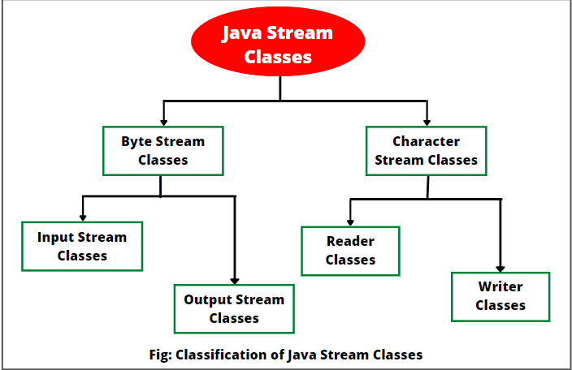

Slide 3
Byte Stream
Byte stream is used to read and write a single byte (8 bits) of data.
All byte stream classes are derived from base abstract classes called InputStream and OutputStream.
Character Stream
Character stream is used to read and write a single character of data.
All the character stream classes are derived from base abstract classes Reader and Writer.

Slide 4
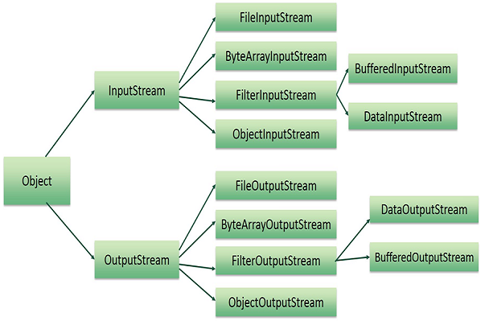
Byte Stream

Slide 5
Modifier and Type | Method and Description
Void close() | Closes this output stream and releases any system resources associated with this stream.
Void flush() | Flushes this output stream and forces any buffered output bytes to be written out.
Void write(byte[] b) | Writes b.length bytes from the specified byte array to this output stream.
Void write(byte[] b, int off, int len) | Writes len bytes from the specified byte array starting at offset off to this output stream.
abstract void write(int b) | Writes the specified byte to this output strea

Slide 6
FileInputStream
FileInputStream stream is used for reading data from the files.
Commonly used constructors of FileInputStream:
FileInputStream(String filePath)
FileInputStream(File fileobj)
Either can throw a FileNotFoundException
Here filePath is the full path name of a file,
and fileObj is a File object that describes the file.
File f=new File(“input.txt”);
FileInputStream f0=new FileInputStream(“input.txt”);
FileInputStream f1=new FileInputStream(f);

Slide 7
//Example
import java.io.FileInputStream;
class Fis{
public static void main(String args[]){
int i;
try{
FileInputStream f=new FileInputStream("hello.txt");
while((i=f.read())!=-1){
System.out.print((char)i);
}
}
catch(Exception e)
{
e.printStackTrace();
}
}
}

Slide 8
FileOutputStream:
FileOutputStream is used to create a file and write data into it. It will create a file, if it does not exist.
Commonly used constructors of FileOutputStream:
FileOutputStream(String filePath)
2. FileOutputStream(File fileObj)
3. FileOutputStream(String filePath, boolean append)
4.FileOutputStream(File fileObj, boolean append)

Slide 9
import java.io.FileOutputStream;
class FileOutPutStreamExample {
public static void main(String args[]){
String str = "Welcome to java";
try {
FileOutputStream fos = new FileOutputStream("f1.txt");
byte b[]=str.getBytes();
fos.write(b);
fos.flush();
//Close file after write operation.
fos.close();
System.out.println("Contents written successfully.");
} catch (Exception e) {
e.printStackTrace();
}
}
}

Slide 10
ByteArrayInputStream
The ByteArrayInputStream class allows a buffer in the memory to be used as an InputStream. The input source is a byte array.
ByteArrayInputStream class provides the following constructors.
ByteArrayInputStream(byte [] a)
This constructor accepts a byte array as a parameter.
ByteArrayInputStream(byte [] a, int off, int len)
This constructor takes an array of bytes, and two integer values, where off is the first byte to be read and len is the number of bytes to be read.

Slide 11
import java.io.ByteArrayInputStream;
public class ReadExample {
public static void main(String[] args) throws IOException {
byte[] buf = { 35, 36, 37, 38 };
// Create the new byte array input stream
ByteArrayInputStream byt = new ByteArrayInputStream(buf);
int k = 0;
while ((k = byt.read()) != -1) {
//Conversion of a byte into character
char ch = (char) k;
System.out.println("ASCII value of Character is:" + k + "; Special character is: " + ch);
}
}
}

Slide 12
available() Method
To get the number of available bytes in the input stream, we can use the available()
byte[] array = { 1, 2, 3, 4 };
ByteArrayInputStream input = new ByteArrayInputStream(array);
System.out.println("Available bytes at the beginning: " +input.available());
skip() Method
To discard and skip the specified number of bytes, we can use the skip() method
byte[] array = { 1, 2, 3, 4 };
ByteArrayInputStream input = new ByteArrayInputStream(array);
input.skip(2);

Slide 13
ByteArrayOutputStream
The ByteArrayOutputStream class of the java.io package can be used to write an array of output data (in bytes).
It extends the OutputStream abstract class.
Java ByteArrayOutputStream class is used to write common data into multiple files. In this stream, the data is written into a byte array which can be written to multiple streams later.
The ByteArrayOutputStream holds a copy of data and forwards it to multiple streams.
The buffer of ByteArrayOutputStream automatically grows according to data.
// Creates a ByteArrayOutputStream with default size
ByteArrayOutputStream out = new ByteArrayOutputStream();
Here, we have created an output stream that will write data to an array of bytes with default size 32 bytes. However, we can change the default size of the array.
// Creating a ByteArrayOutputStream with specified size ByteArrayOutputStream out = new ByteArrayOutputStream(int size

Slide 14
import java.io.ByteArrayOutputStream;
public class DataStreamExample {
public static void main(String[] args) throws IOException{
FileOutputStream fout1=new FileOutputStream("C:\\Users\\student\\Desktop\\javaprograms\\f1.txt");
FileOutputStream fout2=new FileOutputStream("C:\\Users\\student\\Desktop\\javaprograms\\f2.txt");
ByteArrayOutputStream bout=new ByteArrayOutputStream();
bout.write(65);
bout.writeTo(fout1);
bout.writeTo(fout2);
bout.flush();
bout.close();
System.out.println("Success...");
}
}

Slide 15
Filter Streams
Filter Streams filters data as they read and write data in the Input Stream, filters it and pass it on to the underlying Streams. Filter Streams are
FilterInputStream(InputStream is)
FilterOutputStream(OutputStream os)
FilterInputStream
FilterInputStream in Java is a concrete subclass class of InputStream class that filters data of an underlying stream. It implements Closeable and AutoCloseable interfaces.
FilterInputStream class has four important subclasses that are as follows:
BufferedInputStream
DataInputStream
LineNumberInputStream
PushbackInputStream

Slide 16
import java.io.*;
public class DataStreamExample {
public static void main(String[] args) throws IOException{
File data = new File("C:\\Users\\student\\Desktop\\javaprograms\\f1.txt");
FileInputStream file = new FileInputStream(data);
BufferedInputStream filter = new BufferedInputStream(file);
int k =0;
while((k=filter.read())!=-1){
System.out.print((char)k);
}
file.close();
filter.close();
}
}

Slide 17
FilterOutputStream
FilterOutputStream in Java is a concrete subclass class of OutputStream class that filters data of an underlying output stream.
FilterInputStream class has four important subclasses that are as follows:
BufferedOutputStream,
CheckedOutputStream,
DataOutputStream,
DeflaterOutputStream,
DigestOutputStream,
InflaterOutputStream,
PrintStream

Slide 18
DataInputStream
DataInputStream in Java is a filter input stream that provides methods for reading Java’s standard data types.
It enables you conveniently to read strings and all primitive data types such as int, float, long, double, etc from a stream.
Java DataInputStream reads bytes from an underlying stream and converts them into suitable primitive-type values or strings.
It reads them to its underlying byte stream and encodes these values in a machine-independent way.
The basic input stream provides read methods only for reading bytes or characters. If we want to read the primitive data types, we need to use a filter class DataInputStream.
DataInputStream class works as wrappers on the existing input stream to filter data in the original stream.

Slide 19
Constructor of DataInputStream
DataInputStream​(InputStream inputStream):
This constructor creates a DataInputStream object that uses the specified underlying InputStream. Here, inputStream defines the input stream from which data will be read.
A data input stream object for input can be created as follows:
FileInputStream fis = new FileInputStream(String filename); DataInputStream dis = new DataInputStream(fis);

Slide 20
DataOutputStream in Java is a filter output stream that provides methods for writing Java’s standard data types.
It enables you conveniently to write strings and all primitive data types such as boolean, int, float, long, etc to a stream.
Java DataOutputStream first converts primitive-type values or strings into bytes and then writes them to the underlying output stream in an appropriate way.
Using data input stream, we can then read the data back in. Thus, DataOutputStream works as wrappers on the existing output stream to filter data in the original stream.
Java DataOutputStream class declaration
DataOutputStream class extends FilterOutputStream class that extends OutputStream. It implements the interface DataOutput to use methods defined in the DataOutput interface.

Slide 21
Constructor of DataOutputStream class
DataOutputStream class defines only a single constructor in Java that is as follows:
DataOutputStream​(OutputStream outputStream):
This constructor creates a DataOutputStream object that uses the specified underlying OutputStream. Here, outputStream defines the output stream to which data will be written.
A data output stream object for output can be created as follows:
FileOutputStream fos = new FileOutputStream(String filename);
DataOutputStream dos = new DataOutputStream(fos);
These two statements basically wrap dos on fos and use it as a filter
To append data to an existing file, use the following syntax:
FileOutputStream fos = new FileOutputStream(new File(String filename), true)
DataOutputStream dos = new DataOutputStream(fos); or,
FileOutputStream fos = new FileOutputStream(String filename, true);
DataOutputStream dos = new DataOutputStream(fos);

Slide 22
import java.io.*;
public class DataStreamExample {
public static void main(String[] args) throws IOException{
FileOutputStream fos=new FileOutputStream("C:\\Users\\student\\Desktop\\javaprograms\\f1.txt");
DataOutputStream dos=new DataOutputStream(fos);
dos.writeInt(100);
dos.writeDouble(10.5);
dos.writeChar(75);
dos.writeBoolean(true);
DataInputStream dis=new DataInputStream(new FileInputStream("C:\\Users\\student\\Desktop\\javaprograms\\f1.txt"));
int i=dis.readInt();
char s=dis.readChar();
double d=dis.readDouble();
boolean b=dis.readBoolean();
System.out.println(i+" "+s+" "+d+" "+b);
}
}

Slide 23
BufferedInputStream
The BufferedInputStream class of the java.io package is used with other input streams to read the data (in bytes) more efficiently.
It extends the InputStream abstract class.
Working of BufferedInputStream
The BufferedInputStream maintains an internal buffer of 8192 bytes.
During the read operation in BufferedInputStream, a chunk of bytes is read from the disk and stored in the internal buffer. And from the internal buffer bytes are read individually.
Hence, the number of communication to the disk is reduced. This is why reading bytes is faster using the BufferedInputStream.

Slide 24
Create a BufferedInputStream
In order to create a BufferedInputStream, we must import the java.io.BufferedInputStream package first.
// Creates a FileInputStream
FileInputStream file = new FileInputStream(String path);
// Creates a BufferedInputStream
BufferedInputStream buffer = new BufferInputStream(file);
In the above example, we have created a BufferdInputStream named buffer with the FileInputStream named file.
Here, the internal buffer has the default size of 8192 bytes. However, we can specify the size of the internal buffer as well.
// Creates a BufferedInputStream with specified size internal buffer
BufferedInputStream buffer = new BufferInputStream(file, int size);
The buffer will help to read bytes from the files more quickly.

Slide 25
import java.io.BufferedInputStream;
import java.io.FileInputStream;
class Main1 {
public static void main(String[] args) {
try {
// Creates a FileInputStream
FileInputStream file = new FileInputStream("f1.txt");
// Creates a BufferedInputStream
BufferedInputStream input = new BufferedInputStream(file);
// Reads first byte from file
int i = input .read();
while (i != -1) {
System.out.print((char) i);
// Reads next byte from the file
i = input.read();
}
input.close();
}
catch (Exception e) {
e.getStackTrace();
} } }

Slide 26
// available() Method
import java.io.FileInputStream;
import java.io.BufferedInputStream;
public class Main1 {
public static void main(String args[]) {
try {
// Suppose, the input.txt file contains the following text
// This is a line of text inside the file.
FileInputStream file = new FileInputStream("f1.txt");
// Creates a BufferedInputStream
BufferedInputStream buffer = new BufferedInputStream(file);
// Returns the available number of bytes
System.out.println("Available bytes at the beginning: " + buffer.available());
// Reads bytes from the file
buffer.read();
buffer.read();
buffer.read();
// Returns the available number of bytes
System.out.println("Available bytes at the end: " + buffer.available());
buffer.close();
}
catch (Exception e) {
e.getStackTrace();
} } }

Slide 27
// skip() Method
import java.io.FileInputStream;
import java.io.BufferedInputStream;
public class Main1 {
public static void main(String args[]) {
try {
// Suppose, the input.txt file contains the following text
// This is a line of text inside the file.
FileInputStream file = new FileInputStream("f1.txt");
// Creates a BufferedInputStream
BufferedInputStream buffer = new BufferedInputStream(file);
// Skips the 5 bytes
buffer.skip(5);
System.out.println("Input stream after skipping 5 bytes:");
// Reads the first byte from input stream
int i = buffer.read();
while (i != -1) {
System.out.print((char) i);
// Reads next byte from the input stream
i = buffer.read();
}
// Closes the input stream
buffer.close();
}
catch (Exception e) {
e.getStackTrace();
} } }

Slide 28
BufferedOutputStream
The BufferedOutputStream class of the java.io package is used with other output streams to write the data (in bytes) more efficiently.
It extends the OutputStream abstract class.
Working of BufferedOutputStream
The BufferedOutputStream maintains an internal buffer of 8192 bytes.
During the write operation, the bytes are written to the internal buffer instead of the disk. Once the buffer is filled or the stream is closed, the whole buffer is written to the disk.
Hence, the number of communication to the disk is reduced. This is why writing bytes is faster using BufferedOutputStream.

Slide 29
Create a BufferedOutputStream
In order to create a BufferedOutputStream, we must import the java.io.BufferedOutputStream package first. Once we import the package here is how we can create the output stream.
// Creates a FileOutputStream
FileOutputStream file = new FileOutputStream(String path);
// Creates a BufferedOutputStream
BufferedOutputStream buffer = new BufferOutputStream(file);
In the above example, we have created a BufferdOutputStream named buffer with the FileOutputStream named file.
Here, the internal buffer has the default size of 8192 bytes. However, we can specify the size of the internal buffer as well.
// Creates a BufferedOutputStream with specified size internal buffer
BufferedOutputStream buffer = new BufferOutputStream(file, int size);
The buffer will help to write bytes to files more quickly.

Slide 30
import java.io.FileOutputStream;
import java.io.BufferedOutputStream;
public class Main1 {
public static void main(String[] args) {
String data = "This is a line of text inside the file";
try {
// Creates a FileOutputStream
FileOutputStream file = new FileOutputStream("output.txt");
// Creates a BufferedOutputStream
BufferedOutputStream output = new BufferedOutputStream(file);
byte[] array = data.getBytes();
// Writes data to the output stream
output.write(array);
output.close();
}
catch (Exception e) {
e.getStackTrace();
} } }

Slide 31
flush() Method
To clear the internal buffer, we can use the flush() method. This method forces the output stream to write all data present in the buffer to the destination file
import java.io.FileOutputStream;
import java.io.BufferedOutputStream;
public class Main1{
public static void main(String[] args) {
String data = "This is a demo of the flush method";
try {
// Creates a FileOutputStream
FileOutputStream file = new FileOutputStream(" f1.txt");
// Creates a BufferedOutputStream
BufferedOutputStream buffer = new BufferedOutputStream(file);
// Writes data to the output stream
buffer.write(data.getBytes());
// Flushes data to the destination
buffer.flush();
System.out.println("Data is flushed to the file.");
buffer.close();
}
catch(Exception e) {
e.getStackTrace();
} } }

